Slide 1
Debt Portfolio
Should we purchase it?

Slide 2
Agenda
Problem Definition
Gather The Data
Exploratory Data Analysis (EDA)
Build Models
Evaluate Model
Answer Question

Slide 3
Problem Statement
What is it we want to accomplish?

Slide 4
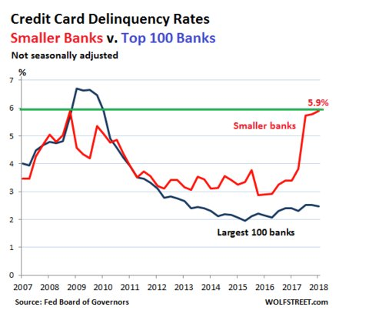
Problem Statement
Delinquency rate on credit-card loan is spiking
Credit-card charge-off rate is spiking as well
Lenders often sell debts they cannot collect. These companies often gather bad debt in portfolios that they sell for pennies on the dollar.
Can we accurately identify if the portfolio is good one to purchase
Notes:
Debt is a large problem in the United States. Many people have fallen into large amounts of debt much of which have a staggering interest rates attached to it. A significant number of these people have chosen not to repay this debt. This can be attributed to any number of reasons (loss of employment, other costs taking precedence, with the interest being so high they don't see any reduction in the principle amount, etc…) After a period of time trying to collect on the debt creditors will write this debt off and sell it in hopes of recouping some of what is owed. The process by which debt is sold comes in the form of debt portfolios i.e., a number of different debtors are bound together and sold as a percentage of the total amount owed. This could me pennies on the dollar.
Getting people who have a demonstrated propensity of ignoring their debts to pay is the key to success when purchasing portfolio s of debt. How then do we do this? It is our belief that people in this position would like a way out. Either to just have the load of the debt off their shoulders, or to get the credit back so they my buy a house, car, etc… This was implemented successfully with this portfolio by forgiving the interest and fees currently associated with the loan and reducing the interest rate to prime plus 3.

Slide 5
Gather Data
Where does the data come?

Slide 6
Gather Data
The data came in the form of paper spreadsheets.
It was scanned in as 4 PDF documents
Using Abbyy FineReader – Optical Character Recognition (OCR) Software converted the PDF to CSV
Using Excel I did some data cleanup

Slide 7
Exploratory Data Analysis (EDA)
What does the data tell us?

Slide 8
Exploratory Data Analysis (EDA)
Data Dictionary
Column Name | Data Type | Description
Account Number | int64 | Issuers account number
PortID | object | Issuer id
Remaining Balance | float64 | The remaining balance owed
Interests Fees | float64 | Interest and fees associated with the account
Date Opened | datetime64[ns] | Opening date for the card
Charge Off Date | datetime64[ns] | When account was written off by the issuer
Last Pay Date | datetime64[ns] | Last date a payment was made on the loan
Last Pay Amount | float64 | The amount last paid
Last Activity Date | datetime64[ns] | The date of the last payment
Interest Rate % | float64 | Interest rate of the loan
Issuer | object | The issuer of the credit card i.e., Chase, or some other bank
Merchant | object | This is the company that offers the card to its customers i.e., United Airlines Mileage Plus or the bank itself
FCFRA Date | datetime64[ns] | Fair Credit Reporting Act – This is the last time the issuer reported to the credit bureau.
OOS Date | datetime64[ns] | Out of Statute – Six years after the last payment made by the consumer
Account Type | object | Type of debt portfolio
Last Name | object | Debtors last name
First Name | object | Debtors first name
Middle Name | object | Debtors middle name
Address | object | Debtors address
City | object | Debtors city of residence
State | object | Debtors home state
Zip | object | Debtors zipcode
County | object | Debtors home county
SSN | float64 | Debtors social security number
Home Phone | float64 | Debtors home phone number
Employer Phone | float64 | Debtors employers phone number
Cycle | object | How “fresh the account is i.e, how many times did the issuer send it out to a collection agency prior to sale
Paid | int64 | Was the debt paid
Notes:
I created a data dictionary to understand what each field was and if it would help in answering the problem.

Slide 9
Exploratory Data Analysis (EDA)
Understanding how the manual analysis was done
Denver metro local
Home owner weighted higher then renters
Bankruptcy check
Look to see if they were married
Remaining balance < 15k
Interest and Fees
Didn’t look at interest rates of 8%
Look at the “Cycle” – How many times the loan has been sent to a collection agency
Number of days until Out of Statute
Last Pay Amount
Notes:
The first 4 items where filtered by the broker when the portfolio was requested

Slide 10
Feature Engineering
Creating new insights from the given data

Slide 11
Feature Engineering
Creating insights from the given data
The “Cycle” column contained three values
SECONDARY
TERTIARY
QUATERNARY
Number of days until Out of Statute
Notes:
The Cycle column determines the “freshness” of the loan i.e., how long has it been delinquent. Needed to dummy the Cycle column so we can do analysis on it. Creating dummy merely means to change the words to a number in this case 0, 1, 2 respectively.
The OOS date or Out of Statue date is the last day any litigation can be brought to the debtor, which is 6 years from the last activity date. Activity date meaning the last date the issuer of the loan had any contact with the debtor. The longer the away the better chance of collecting

Slide 12
Building Predictive Models
Forecasting Outcomes

Slide 13
Building Predictive Models
Creating insights from the given data
The “Cycle” column contained three values
Secondary
Tertiary
Quintenary
Number of days until Out of Statute
Notes:
Predictive modelling is a process that uses data and probability to forecast outcomes. Each model is made up of a number of predictors, which are variables that are likely to influence future results. Once the data has been collected and cleaned a model is fitted to that data and predictions are then able to be made.

